Slide 1

Continuing Education Course in Digitalisation
Didactic workshop
26th of May 2026
Med støtte fra

Slide 2
GOALS
To equip the university lecturers to understand the target audience of the course
To create a common thread throughout the learning process for the participants

Slide 3
AGENDA
STEM Academy and the panel meeting
The structure of the course
Knowledge sharing from the high school teachers
Model for inquiry-based science education
Experience and learnings from previous courses
Thoughts and inputs on the three subjects
Tasks for the university lecturers
Breaks throughout

Slide 4
WHO ARE WE?

Slide 5
STEM ACADEMY

Slide 6
PROJECT STEM ACADEMY
6 FAG
STEM ACADEMY
Continuing Education for high school teachers in the STEM-subjects
Provides access to current research-based knowledge to benefit high school teachers teaching
The University of Copenhagen creates and evolves the further education course working closely with high school teacher and more.
Supported by the Novo Nordisk Fundation
From 2024-2027

Slide 7
”
The purpose is to give participants inspiration and ideas as well as simple tools that they can further develop and use in their own teaching.
Notes:
Forventningsafstemning

Slide 8
PANEL MEETING
12th of March 2026

Slide 9
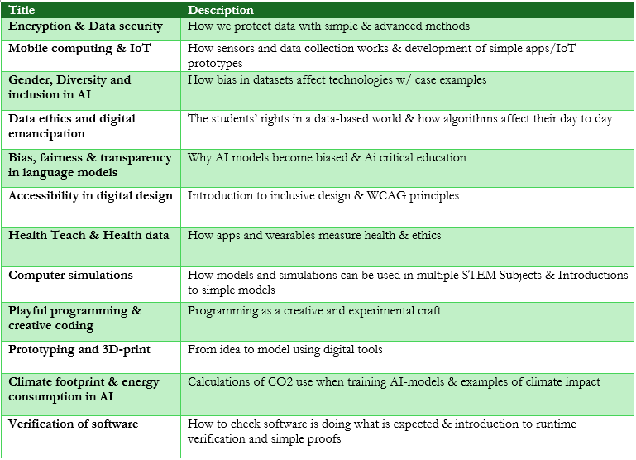
PANEL MEETING
Representatives from:
Three involved high schools
Consultants from Ministry of Education in Physics, Maths & Informatics
UCPH:
Jens Dolin, Sara Boline Lise Bang Ingvartsen, Anne Karina Steen & Mikkel Gorm Kærgård Jørgensen

Slide 10
PANEL MEETING
Chosen subjects:
Cryptography
Internet of Things
Mobile computing

Slide 11
PANEL MEETING – GENERAL COMMENTS
A wish for specific processes and examples
Multidisciplinary lenses
Focus on STEM but consider social science areas and impact
Uses for STX and HTX

Slide 12
LOCATIONS AND DATES FOR COURSE DAYS 2026
Mulernes Legatskole (Odense) | 23/09 23/09 22/10 22/10 | Module 1: Cryptography (Sara) Module 2: Internet of Things (Daniel) Module 3: Mobile computing (Teresa) Module 4: From Research to Education – Development of Teaching Courses (DANISH) (Jens)
Sukkertoppen Gymnasium (Copenhagen) | 21/09 21/09 20/10 20/10 | Module 1: Cryptography (Sara) Module 2: Internet of Things (Daniel) Module 3: Mobile computing (Teresa) Module 4: From Research to Education – Development of Teaching Courses (DANISH) (Jens)
Herning Gymnasium (Herning) | 28/09 28/09 27/10 27/10 | Module 1: Cryptography (Sara) Module 2: Internet of Things (Daniel) Module 3: Mobile computing (Teresa) Module 4: From Research to Education – Development of Teaching Courses (DANISH) (Jens)

Slide 13
STRUCTURE OF THE COURSE

Slide 14
MODULE STRUCTURE
3 subject based modules
1 didactic module
Module 1
Introduction
Academic presentation and exercises
Summary, reflection & evaluation.
Module 2
Presentation of reflections from previous modules
Academic presentation and exercises
Summary, reflection & evaluation.
Module 3
Presentation of reflections from previous modules
Academic presentation and exercises
Summary, reflection & evaluation.
Module 4
Presentation of reflections from previous modules
Development of high school courses
Round off
All the course days run from 9am – 5pm. The participants will arrive from 8.30am for check in. The Modules are from 9am – 12.40 & 1.30pm – 5pm, with a lunch break between.
Sara Boline Lise Bang Ingvartsen is the facilitator for all 4 modules.

Slide 15
COURSE STRUCTURE
Module 1-3
Introduction
Academic presentation and exercises
Summary, reflection & evaluation
Short oral evaluation of the module:
- Which elements from the module did you find especially inspirational?
- Which elements from this module do you think could engage and spark interest with your students?
- How could these course elements work in your subject's coursework?

Slide 16
COURSE STRUCTURE
Participants decide which of the subjects from the 3 previous modules they would like to work with in module 4
Modul 1
Introduction
Academic presentation and exercises
Summary, reflections & evaluation
Modul 2
Presentation of reflections from the previous module
Academic presentation and exercises
Summary, reflections & evaluation
Modul 3
Presentation of reflections from the previous module
Academic presentation and exercises
Summary, reflections & evaluations
Modul 4
Presentation of reflections from the previous modules
Development of high school courses
Round off

Slide 17
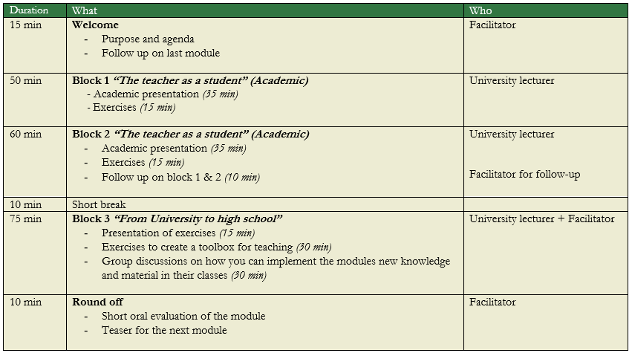
MODULE 1-3 STRUCTURE

Slide 18
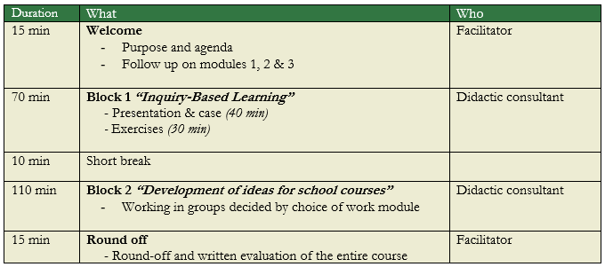
MODULE 4: FROM RESEARCH TO TEACHING – DEVELOPMENT OF TEACHING COURSES

Slide 19
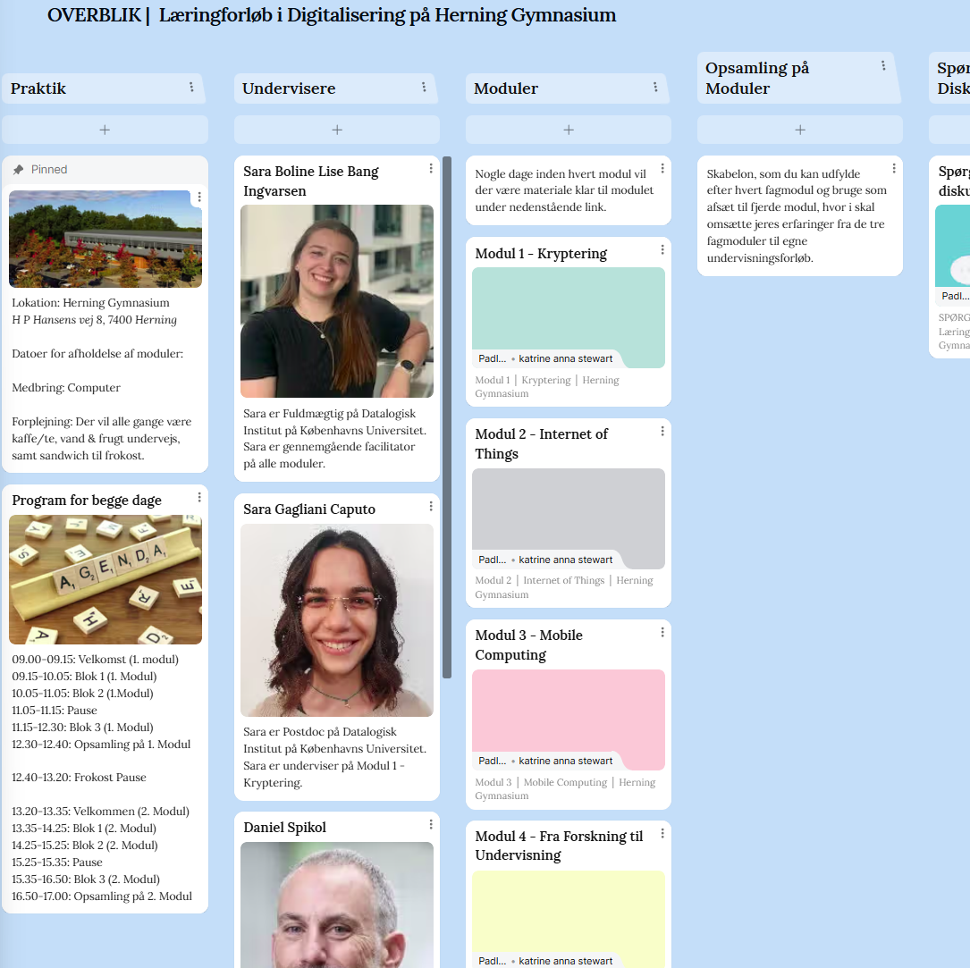
LEARNING PLATFORM
PADLET

Slide 20
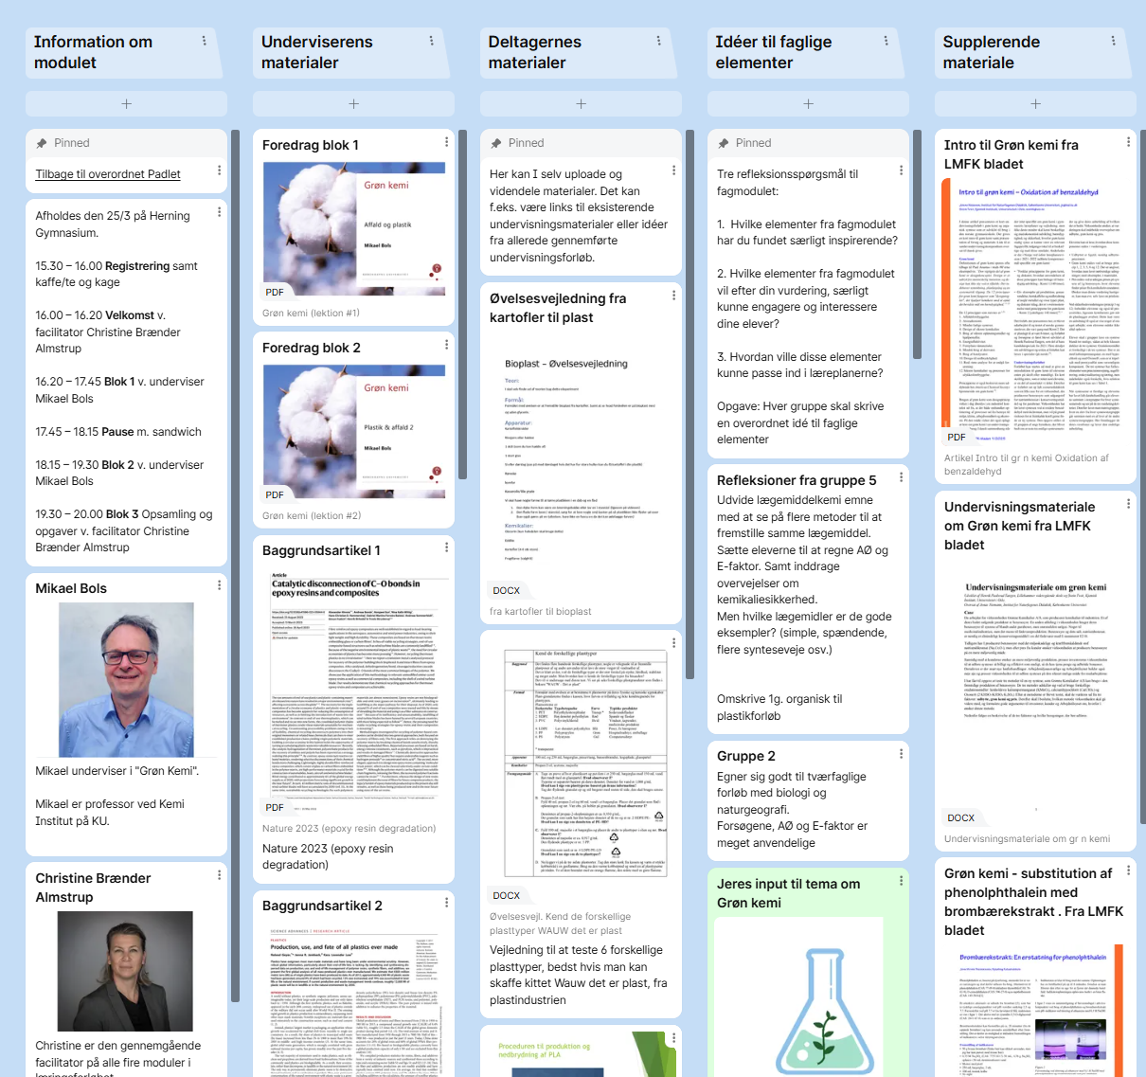
LEARNING PLATFORM:
PADLET
MODULE 1-3
University lecturers:
Learning materials & exercises
Material the teachers can further develop for their own classes
Participants
Knowledge sharing about the materials
Exchange ideas

Slide 21

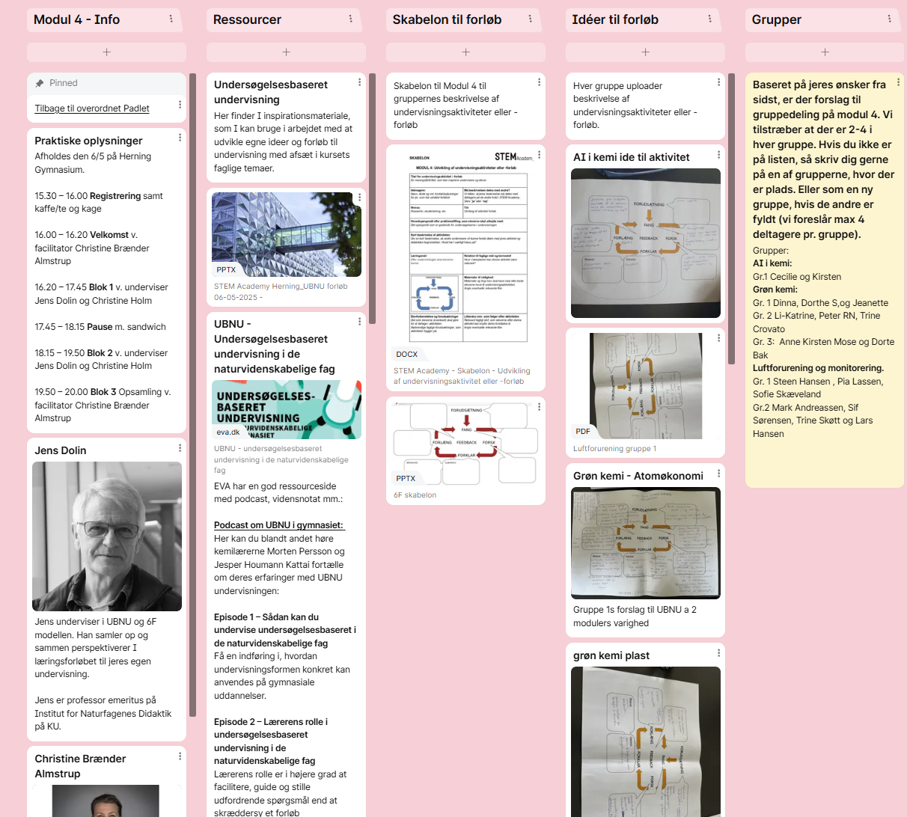
LÆRINGSPLATFORM:
PADLET
MODUL 4
Depart. of Science Education:
Podcasts and articles about IBSE etc.
Subject specific examples and links
Templates the participants can use to describe ideas for their own classes
Participants:
Sparring on suggestions for class activities or courses

Slide 22
KNOWLEDGE SHARING FROM THE HIGH SCHOOLS

Slide 23
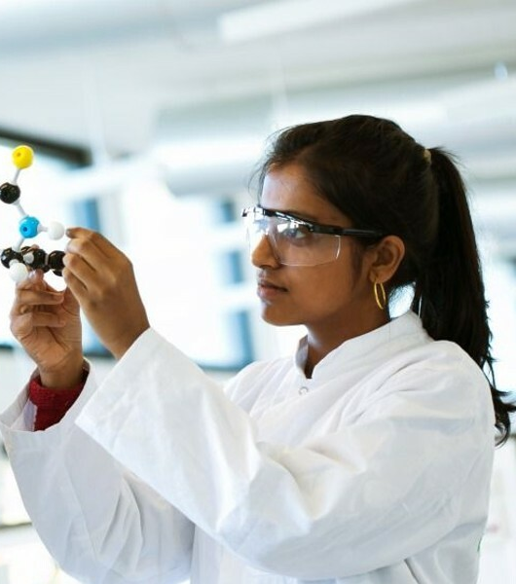
Core substance, that relates to the three themes
The participants and high school student's academic level
The differences in teaching in the various high school forms (HTX, STX, HHX)
Materials and exercises that work well in your theme, and that high school teachers can develop further

Slide 24
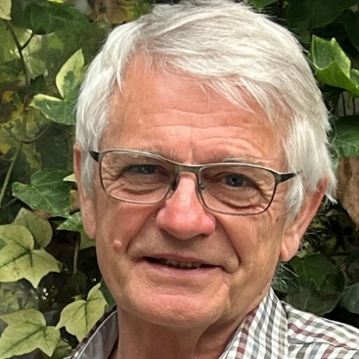
DIDACTIC FRAMEWORK
Jens Dolin – Professor Emeritus

Slide 25
ModulE 4: Transforming the new knowledge into concrete teaching
Module 4 is the most important ☺ (in relation to student learning)
- this is where the knowledge (the concepts, the processes, the insights …) of each of the three subject modules is transformed into teaching, not teaching that transmits the given knowledge to the students, but that teaches the students to identify relevant knowledge and use it on a problem.
In the module, groups of teachers work in a structured format to translate the content of one subject module into concrete teaching plans – with an emphasis on empirically based knowledge creation. The work is – quite schematically – structured according to the phases of the Inquiry Based Science Education approach (IBSE, in Danish UBNU), the 6E (Danish: 6F) model.
Therefore, it is important that the individual subject modules present, discuss, and save materiel from the subject module that can be included in the different phases of the 6F course, and which can then be used in the 4th module. Save material on the padlet!
The 4th module must be seen in connection with each of the first three modules!!!
The teaching plans are presented, discussed and shared on module 4 so that everyone has access to all results.
Jens Dolin, Department of Science Education/Institut for Naturfagenes Didaktik, KU

Slide 26
Knowledge creation rather than KNOWLEDGE acquisition as a didactic driver
(Videns skabelse – Videnskab)
Latour and Woolgar (1979) distinguish between
ready-made-science and science-in-the-making
Products of Science
Uncontroversial Science
Textbook Science
Processes of science
Controversial science, SSI topics
Science in laboratories etc.
(Positivistic epistemology)
(Social constructivist epistemology)
The social processes of the scientific community (cf. Kuhn)
The didactic processes of authentic teaching
Notes:
It is inspired by but not entirely dependent on the ethnomethodological approach. In turn, it served as the inspiration for Actor–network theory (or ANT); many of ANT's core concepts (like transcription, inscription, translation, and the deployment of networks) are present in Laboratory Life

Slide 27
Deductive approach
We tell students what they need to know
The students remember or save it
A task is given for them to demonstrate their knowledge
Inductive approach
A problem is posed
The students must identify relevant knowledge
They learn to apply knowledge to the problem

Slide 28

InduCtivE education
Scenariebaseret undervisning
Problembaseret undervisning
Case-baseret undervisning
Projektarbejde
Inquiry Based Science Education (IBSE)
Undersøgelsesbaseret naturfagsundervisning (UBNU)

Slide 29
IBSE 5E-model / UBNU 6F-modellen
Indsigt i elevernes eksisterende forståelse af fænomener, processer – som synliggøres
Mellem elever og mellem lærer og elever under hele forløbet
FORUDSÆTNING
Elevernes interesse fanges – emnet/problemet gøres relevant og motiverende
Elever anvender den opnåede forståelse i nye sammenhænge -> dybere forståelse
FANG
(Engage)
FORLÆNG (Elaborate)
FEEDBACK
(Evaluation)
FORSK (Explore)
FORKLAR
(Explain)
Eleverne indsamler data og viden – som beskrives, systematiseres og analyseres
Elevernes forsk kobles med fagets forståelser og termer til forklaringsmodeller
Jens Dolin, Institut for Naturfagenes Didaktik, KU

Slide 30
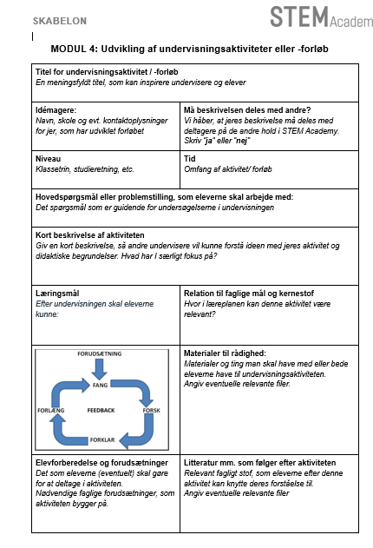
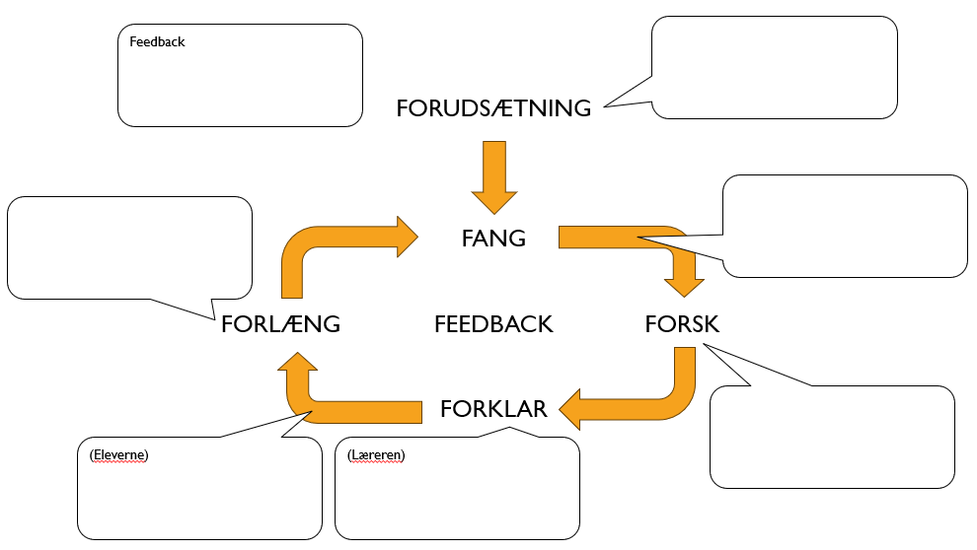
Developping Teaching Plans
4 phases
3) Further development and process description
1) Ideas brain storm
2) Pitch and feedback from sparring group
4) Up-load to padlet.
Present in plenary
Jens Dolin, Institut for Naturfagenes Didaktik, KU

Slide 31
LUNCH

Slide 32
EXPERIENCES FROM PREVIOUS COURSES
(Maths, Chemistry, Physics, P.E)

Slide 33
EXPERIENCES
Difficult to find the right level: “Too difficult to translate for the students…but it must not be too easy for the high school teachers either”
Avoid involving too much ‘hard’ programming/coding
Participants will have new and high-level research as a starting point
Clear expectations: Participants do not bring home finished material but must develop ideas for new courses together with the other participants
Feel free to use elements from the didactic framework in teaching the subject modules 'Walk-the-talk'
Please introduce the didactic framework early in the process

Slide 34
LEARNING PLATFORM:
PADLET
MODULE 1-3
Herning Gymnasium: Front page
Mulernes Legatskole: Front Page
Sukkertoppen Gymnasium: Front Page

Slide 35
THE THREE MODULES – THOUGHTS AND INPUT

Slide 36
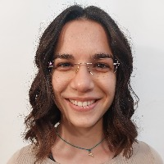
Cryptography
Sara Gagliani Caputo
Postdoc

Slide 37
Cryptography –
STEM Academy
Sara Gagliani Caputo
2026-05-25

Slide 38
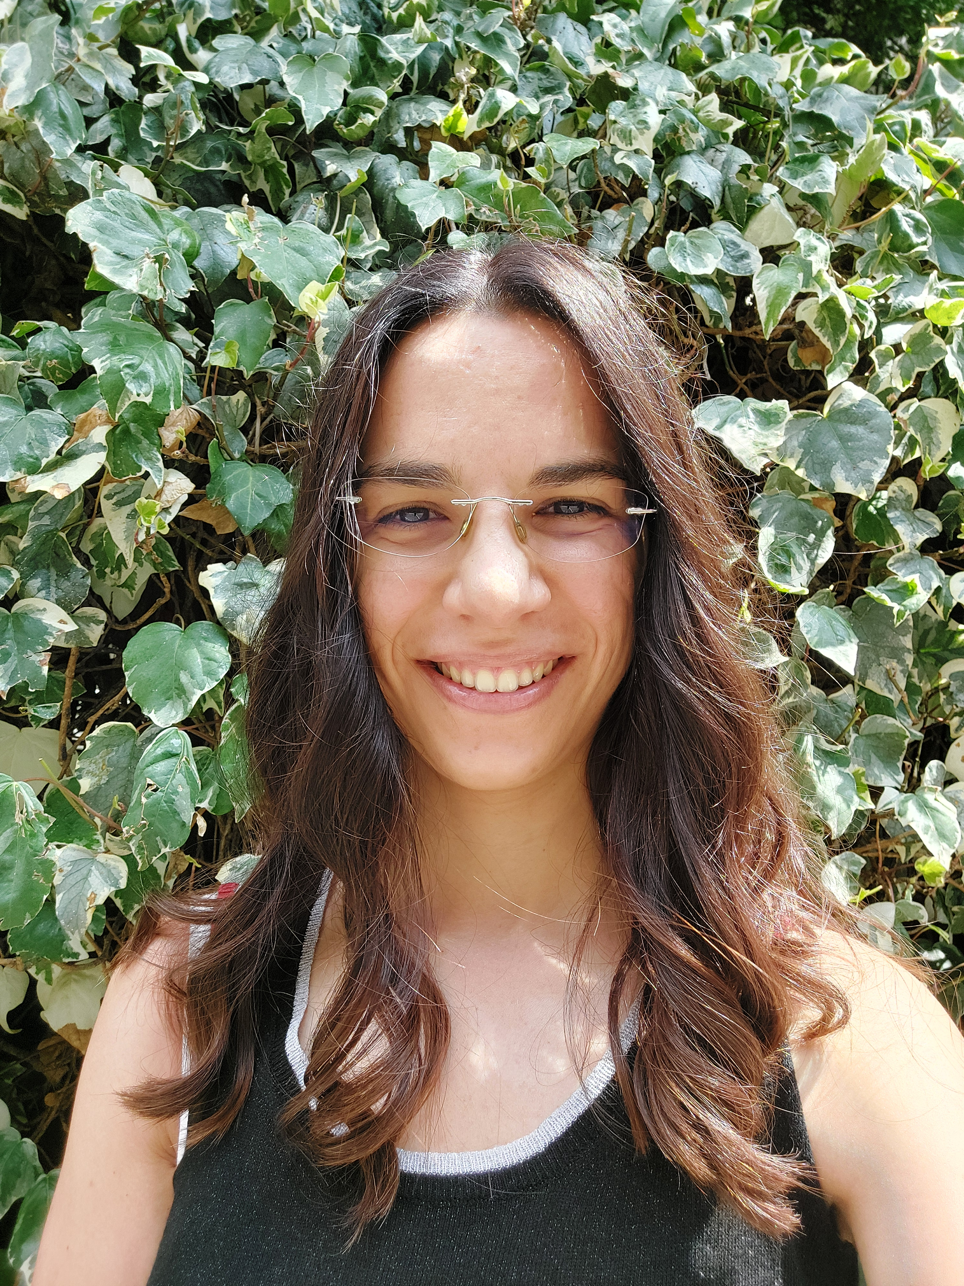
About Me
BSc and MSc in Mathematics (Sapienza University of Rome)
PhD in Mathematics Education (University of Milan)
  Design of Digital Mathematical Discussion
  Students’ collaborative processes and development of collective algebraic thinking
Postdoc in Mathematics Education (University of Milan)
  Professional development courses for teachers on mathematical discussion
  Teacher’s scaffolding in Digital Mathematical Discussion
Postdoc in CSCW (DIKU)
  Neurodiversity (and gender) in Computer Science
  Supervision processes in CS Bachelor and Master projects

Slide 39
Proposal on cryptography for STEM Academy
Cryptography
Introduction and historical references
Symmetric
(Private key)
Asymmetric
(Public key)
Principles, potentialities and limitations
Caesar cypher
EXAMPLE
RSA
Modular arithmetic
MATHS
Euclidean algorithm for greatest common divisor
Algebra of prime numbers

Slide 40
Question hints
What are the mathematical compentences I can assume the teachers will have?
What about these topics can be relevant for teachers to be taught in their classrooms?
Which theoretical and mathematical knowledge can be useful for the other activities?

Slide 41
PANEL MEETING – COMMENTS ON ‘CRYPTOGRAPHY’
Well known theme in STX schools, often used in SRP papers
Concrete processes using symmetrical/ asymmetrical keys
Works with the informatics guidelines
Could likely work on A-level courses
Note: The theme at the panel meeting was cryptography and data security

Slide 42
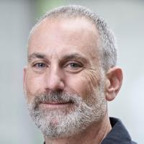
INTERNET OF THINGS
Daniel Spikol
Associate Professor

Slide 43
PANEL MEETING – COMMENTS ON ‘INTERNET OF THINGS’
Could work well as a multidisciplinary project in maths and physics
Arduino already known and used, but there Is a lack of after-education for it
Works for problem-orientated and practical multidisciplinary subjects
Works well in general for multidisciplinary STEM
(Note: In the Panel meeting the course was called Mobile Computing and IoT)

Slide 44
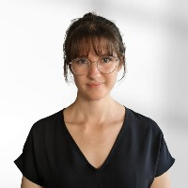
MOBILE COMPUTING
Teresa Hirzle –
Tenure track Assistant Professor

Slide 45
PANEL MEETING – COMMENTS ON ‘MOBILE COMPUTING’
Could work well as a multidisciplinary project in maths and physics
Arduino already known and used, but there Is a lack of after-education for it
Works for problem-orientated and practical multidisciplinary subjects
Works well in general for multidisciplinary STEM
(Note: In the Panel meeting the course was called Mobile Computing and IoT)

Slide 46
TASKS FOR THE UNIVERSITY LECTURERS

Slide 47
BEFORE Your first academic module | DURING The execution of your module at each of the three locations | AFTER Executing all 3 of your modules
Prepare module, block 1, 2 and 3 The material that are to be used during the module must be uploaded to Padlet min. 10 days before (Send to Sara who will upload onto the Padlet) Informal dialogue with Sara Boline Lise Ingvartsen | Make any neccssary changes to the PowerPoint, material etc. (Updates slides are to be sent to Sara) If needed, Informal dialogue with Sara Boline Lise Ingvartsen If necessary, answer any questions asked by the participants on Padlet (Sara will coordinate) | Written evaluation of your module Final evaluation of the whole of STEM Academy (2027)

Slide 48
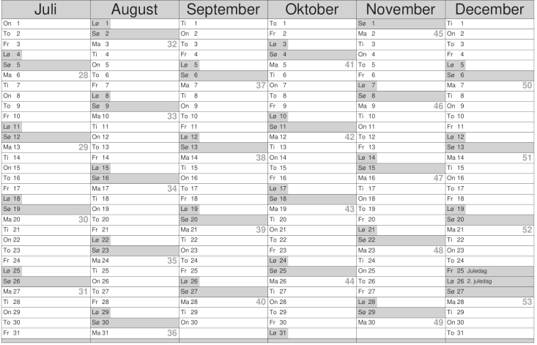
Odense
Copenhagen
Herning
Day 2: T & J
Day 1 S & D
Day 2 T & J
Day 1 S & D
Day 2 T & J
Day 1 S & D

Slide 49
